Slide 1
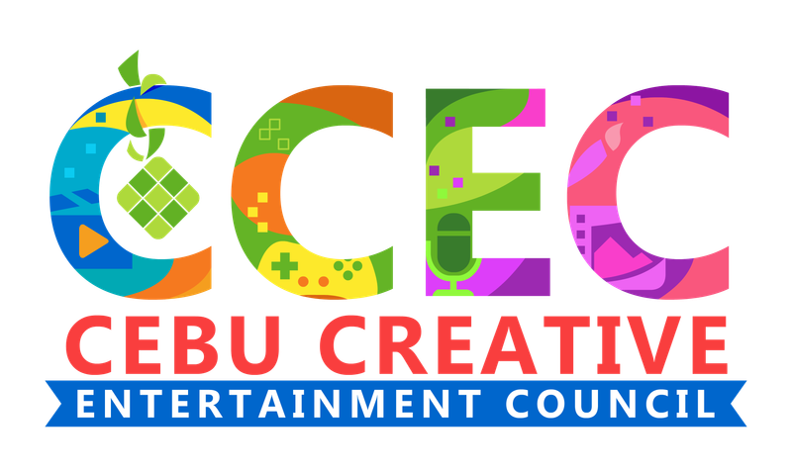
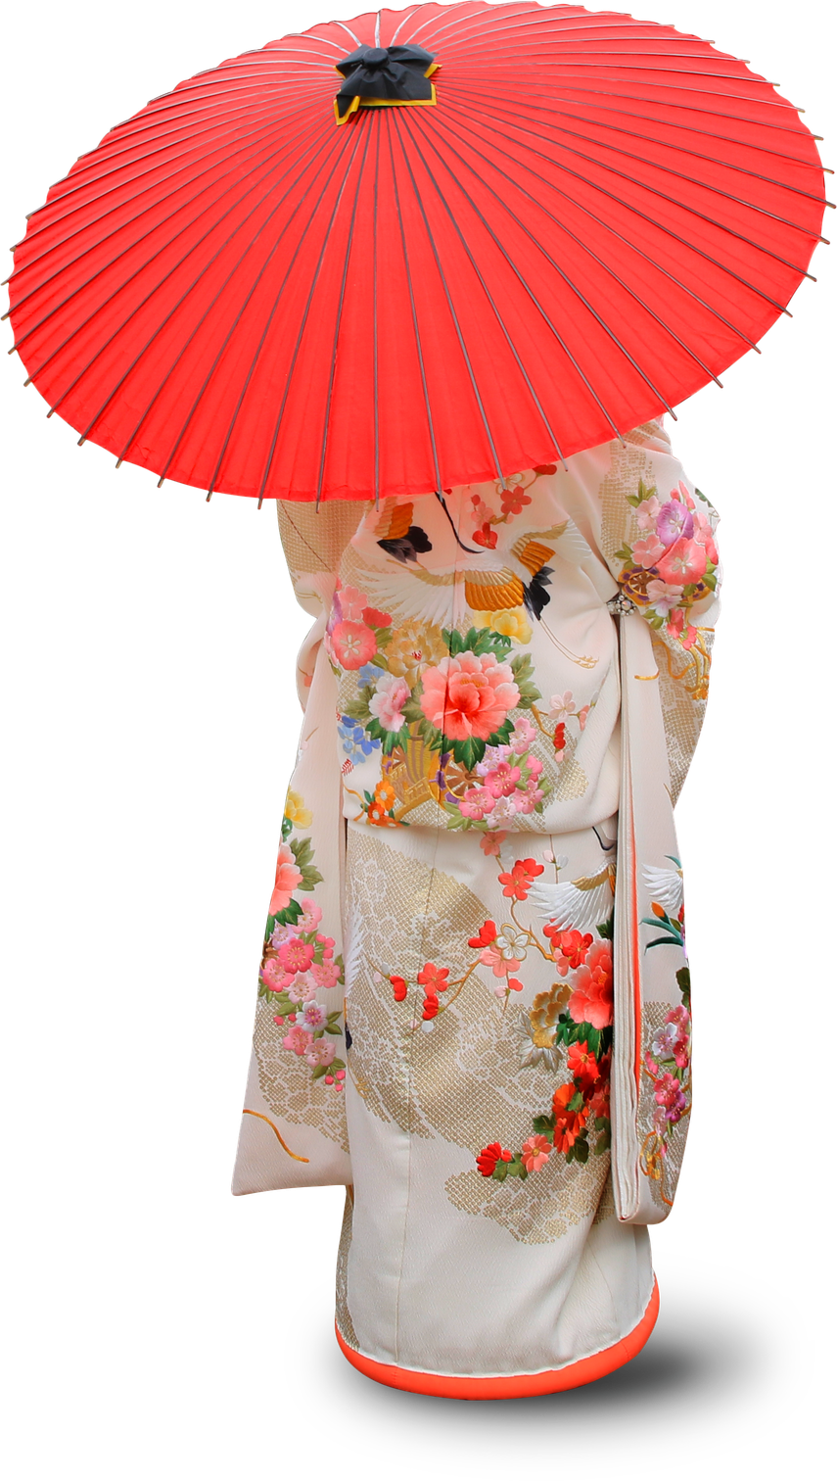
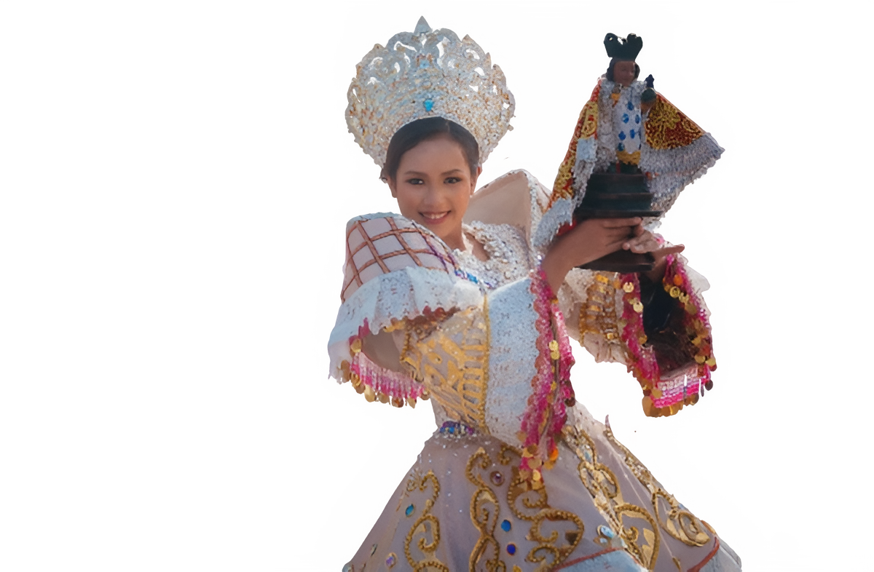



KIZUNA (絆)
Building Enduring Partnership Through Shared Passion
for Creativity Between Japan and the Philippines
Notes:
Kizuna - Bonds.
Deep relationships.
Mutual trust.
Shared purpose.
Long-term commitment.
Exactly what you're proposing.
Your presentation is literally about building Kizuna between Japan and the Philippines.

Slide 2
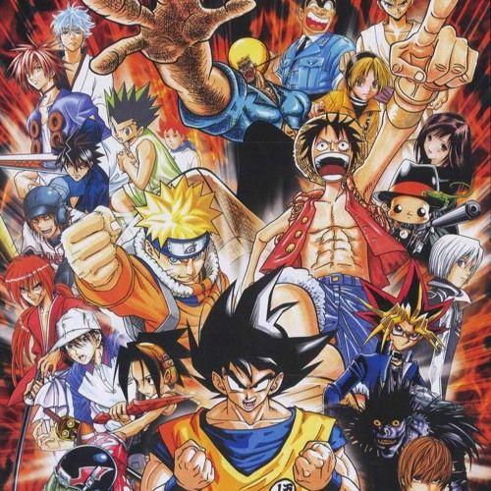
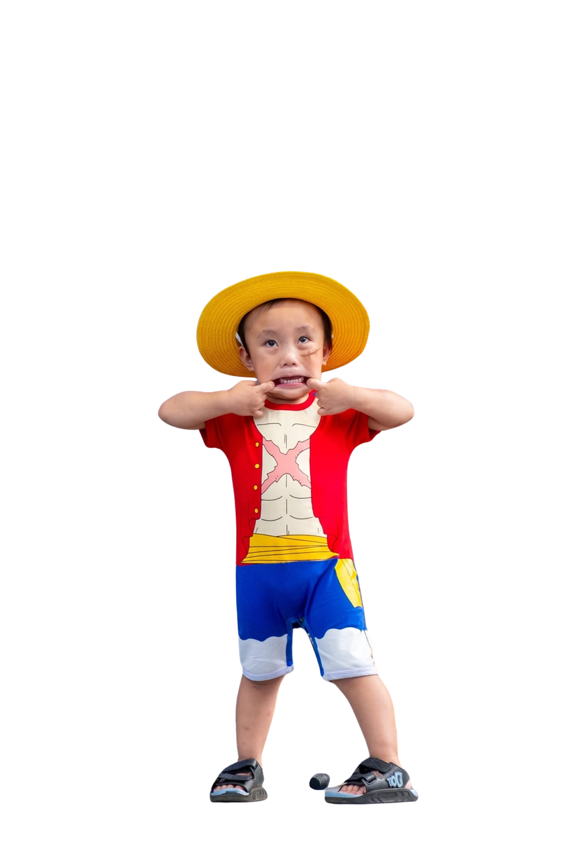
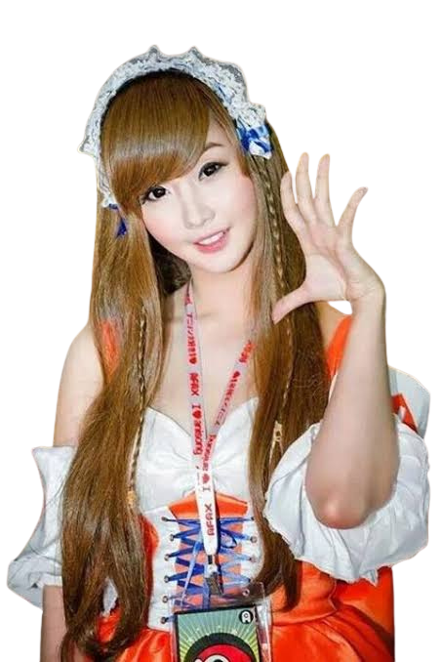
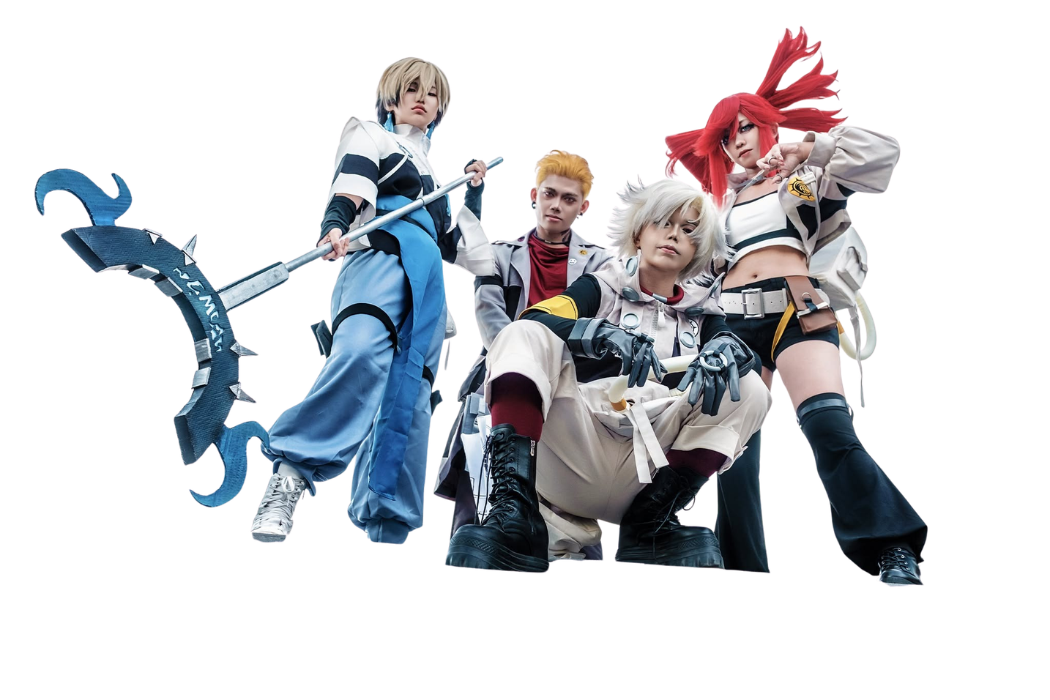
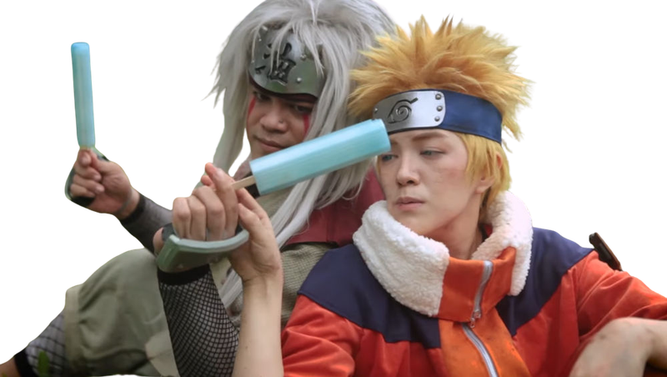
Filipinos have an authentic cultural affinity with Japan

Slide 3
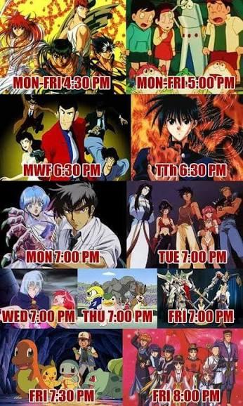


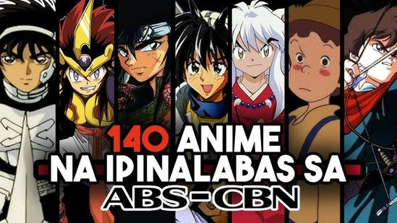
We grew up with Japanese Animation
Notes:
Japanese animation has been part of Filipino households for generations.
Parents introduced anime to their children.
Today,those children are becoming animators.

Slide 4
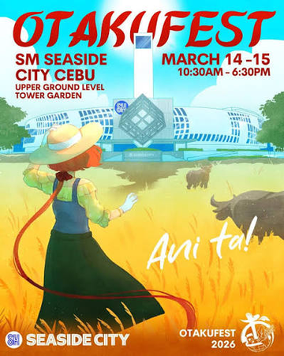

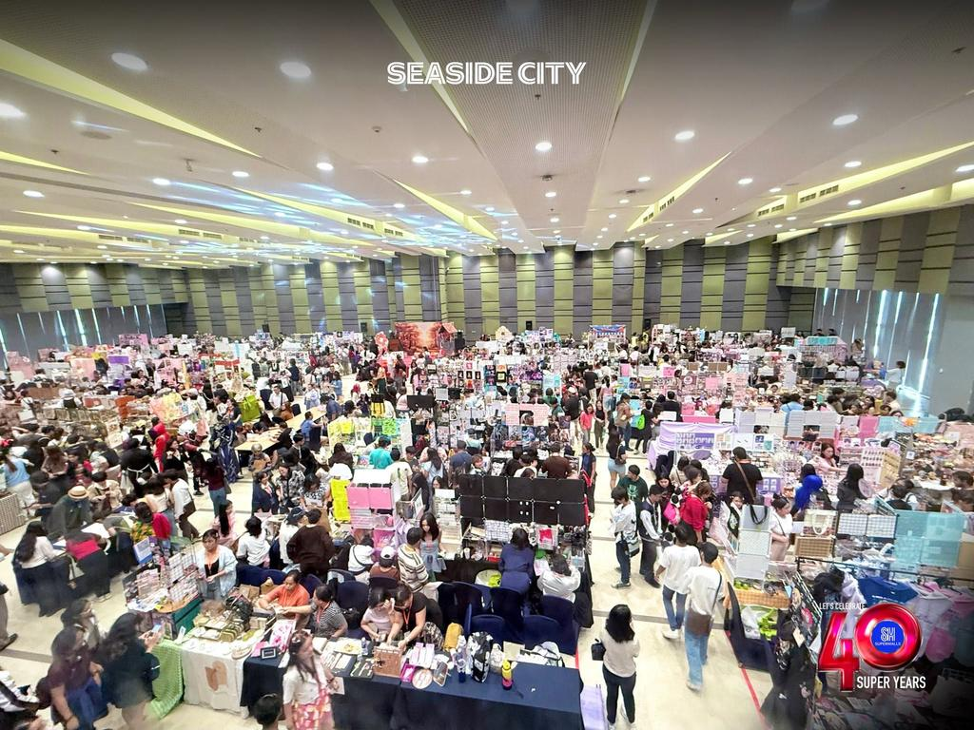
CEBU GENUINELY LOVES JAPANESE MEDIA
From anime and manga to J-pop, Japanese culture resonates deeply across generations.
ANIME CULTURE ALREADY THRIVES
Cosplay events, OtakuFest, Bon Odori Festival, Games & Animation — thriving communities and regular gatherings.
GRASSROOTS ENTHUSIASM IS REAL

Slide 5
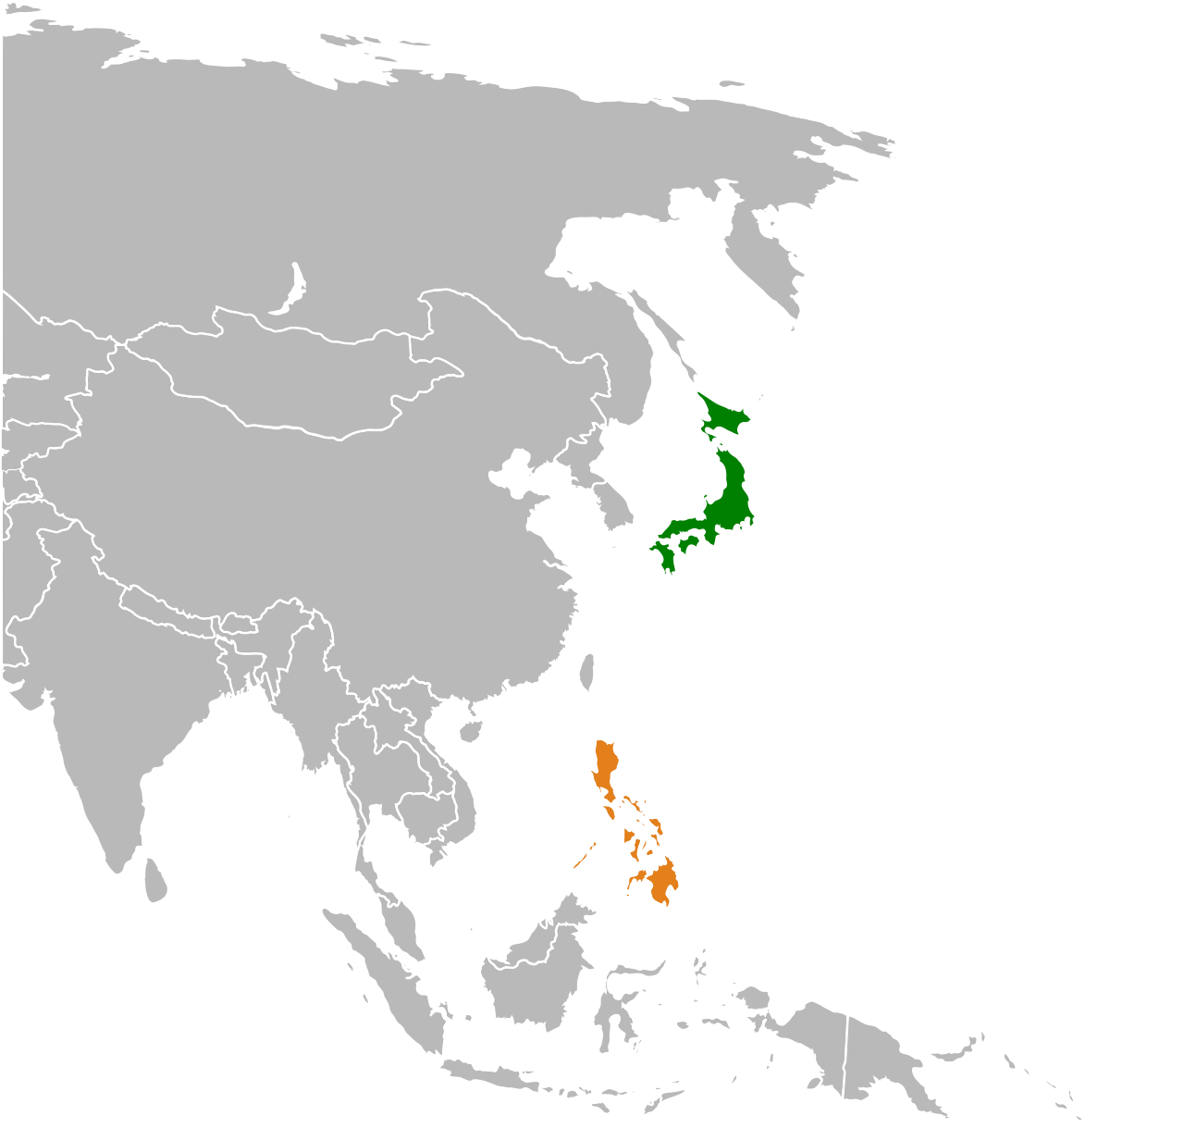
Geographic Location - Operationally Compatible
  One-hour time difference with Japan enables real-time collaboration.
  Faster review cycles.
  Easier meetings.
  Same-day production decisions.
  Reduced communication delays.
Notes:
Geography is good, but geography isn't the real value.
The value is
Operational Compatibility

Slide 6


Culture of Creativity & Collaboration
STRENGTHS
  Active creative community
  Young passionate population
  Growing collaboration between schools and
industry
  Supportive ecosystem for innovation and talent development
A workforce ready to learn Japanese production standards.
  schools and universities
  TESDA and other gov’t agencies
  industry
  CCEC
  private institutions
  government
Notes:
We only dont have a Young and passionate anime community.
but
A workforce ready to learn Japanese production standards
working together that ensures institutional readiness.

Slide 7
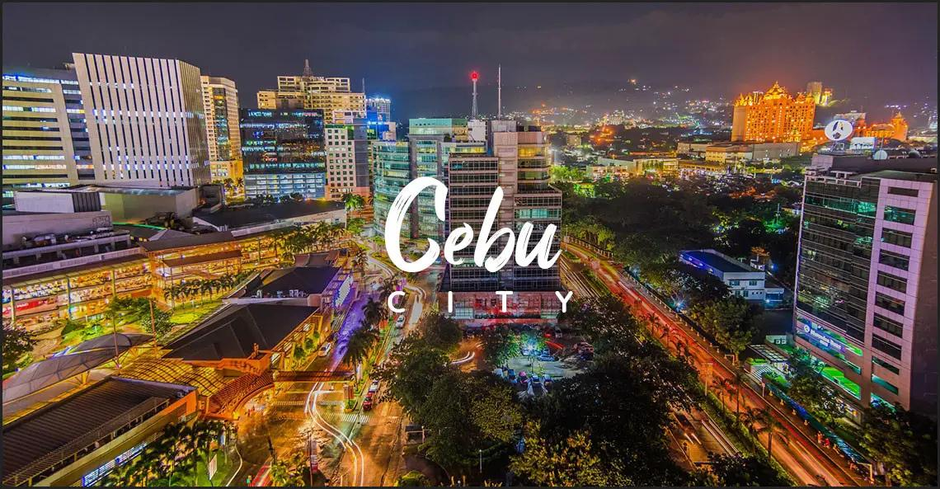
Digital Infrastructure
Today's animation is global. Cebu is ready.
  Cloud workflows.
  Remote review.
  Version control.
  Asset management.
  Modern pipelines.
Notes:
The Philippines already has experience supporting distributed global production through its IT-BPM and outsourcing ecosystem, making collaboration with Japanese studios practical and scalable.

Slide 8
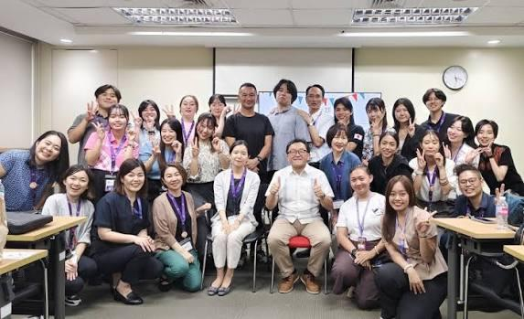
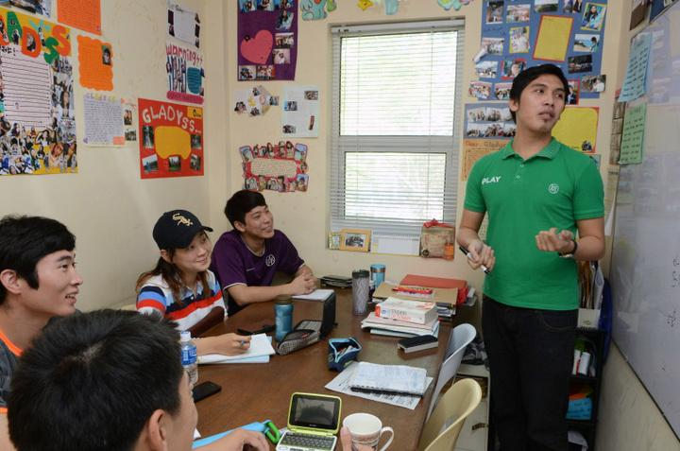
More than language, communication!
Communication reduces production risk.
Good communication means
  fewer revisions
  fewer misunderstandings
  better documentation
  faster approvals
  stronger teamwork
Notes:
The Philippines already has experience supporting distributed global production through its IT-BPM and outsourcing ecosystem, making collaboration with Japanese studios practical and scalable.

Slide 9

Cebu Creative Industry Snapshot
Notes:
Today Cebu already has
animation studios
game studios
outsourcing providers
original IP creators
co-production experience
This demonstrates an existing creative ecosystem rather than isolated freelancers.
Also highlight that studios range from boutique teams to scalable production groups, with capabilities in 2D animation, 3D animation, character design, rigging, modeling, VFX, game art, and more.

Slide 10
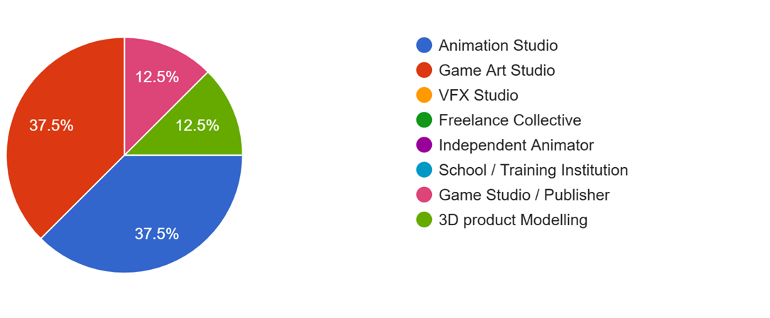
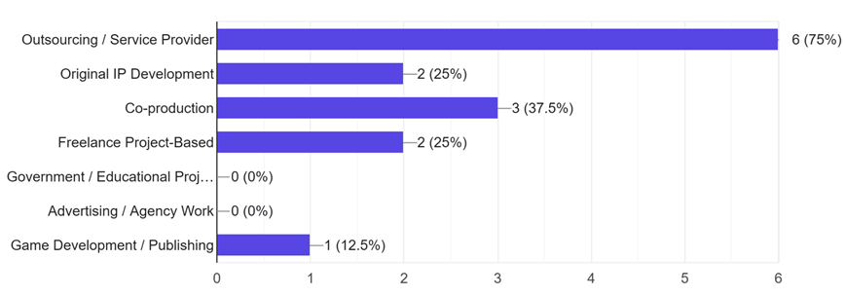
Cebu Creative Snapshot
Cebu Creative Industry Snapshot

Slide 11
ありがとうございます
Daghang Salamat

